Slide 1
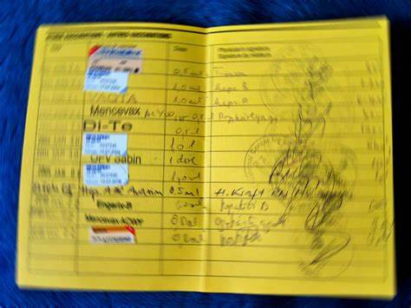
Woman’s Questionnaire: Vaccination Section

Slide 2
Vaccination section structure
Questions to determine if has vaccination card
Q504 – do you have a card
Q505 – did you ever have a card
Q507 – can I see the card
IF has card
Enter the dates of vaccinations into the CAPI system from the card
Ask permission to take photo of card
Take photo of card
IF does not have card, ask questions Q514-Q528A for mother’s recall of vaccinations received
Notes:
At DHS we define a CAPI operation as a

Slide 3
Entering vaccinations from the vaccination card
Vaccination’s dates information should be filled into the CAPI system directly from the card.
When there is more than one eligible child for this section, be certain to match the correct card with the child you are asking about.
Before entering dates from the card, examine the card carefully. The card may list the vaccinations in a different order than the questionnaire.
Dates should be recorded with the day first, then the month and then the year.
Be very careful not to record a scheduled appointment date as a vaccination date
Notes:
At DHS we define a CAPI operation as a

Slide 4
Entering vaccinations from the vaccination card
If there is no date and no check mark next to a specific vaccine,
record ‘00’ in the DAY column
leave the month and year blank; the system will automatically fill the month and year fields with zeros and will then move to the next vaccination.
If the card shows clear evidence that a vaccination was given, but there is no date recorded,
record ‘44’ in the DAY column next to the vaccine and leave the month and year blank; the system add code “44” to the MONTH and code “4444” to the YEAR.
Notes:
At DHS we define a CAPI operation as a

Slide 5
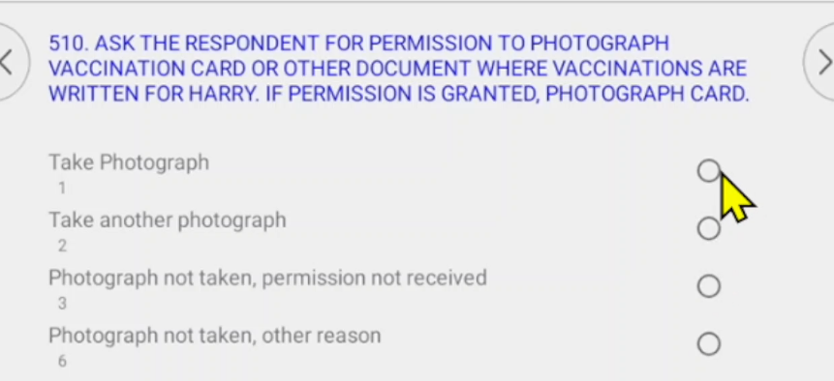
Photographing the card
If there is a card you should ask for permission to photo it
Record response if permission not received or photo not taken for other reasons
Notes:
At DHS we define a CAPI operation as a

Slide 6
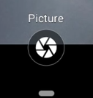

Photographing the card
To take photo, use option 1
Click on circle at bottom to take photo
Click on tick mark to accept photo
Notes:
At DHS we define a CAPI operation as a

Slide 7
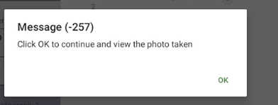

Photographing the card
Click ok to continue and view photo
System will show the photo
Use back button at top left of screen to exit
Notes:
At DHS we define a CAPI operation as a

Slide 8
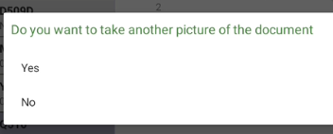
Photographing the card
Click ok to continue and view photo
System will show the photo
Use back button at top left of screen to exit
System will prompt if you wish to take another photo
Say yes or no
Notes:
At DHS we define a CAPI operation as a

Slide 9
Photographing the card
DEMONSTRATION VIDEO
Make sure to check that the photo is readable before accepting it
Take photos of each page of the card that has vaccination records – can take more than one photo for a given card
Notes:
At DHS we define a CAPI operation as a

Slide 10
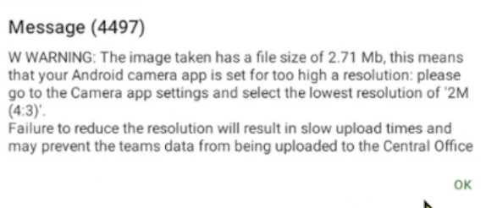
Reducing file size of photo
Need to change default size of photo taken to facilitate file transfers over Bluetooth and internet
Each photo will be 2Mb by default which is too large
System will display message warning about size
Notes:
At DHS we define a CAPI operation as a

Slide 11
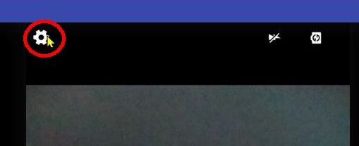
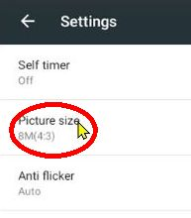
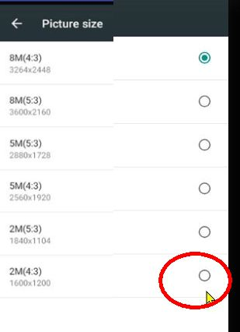
How to reduce photo size
When the photo screen is first displayed, before taking photo, click on cog icon at top left of screen | Click “Picture size” | click on the option at the bottom of the list :2M(4:3) system will accept and reset the default size. click “Back” button to go back to photo
Notes:
At DHS we define a CAPI operation as a

Slide 12
Reducing file size of photo
Only need to set the file size one time, system will remember it afterwards
Do it the first time you take photo
DEMONSTRATION VIDEO
Notes:
At DHS we define a CAPI operation as a

Slide 13
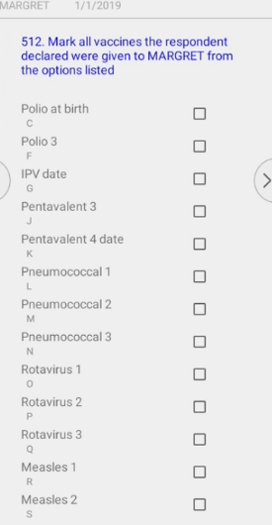
Q512: Mother’s recall of vaccinations received but not marked on ard
Q512 probes for vaccines received but not on card eg during vaccination campaigns
If response is “Yes” system will display list of vaccines not already entered from card
From the options listed, mark all vaccines the respondent mentioned as given to the child and click ‘>’ button. The system will replace the ‘00’ for that vaccination with a ‘66’ in the DAY, “66” in the MONTH, and “6666” in the YEAR next to the vaccine received
Notes:
At DHS we define a CAPI operation as a

Slide 14
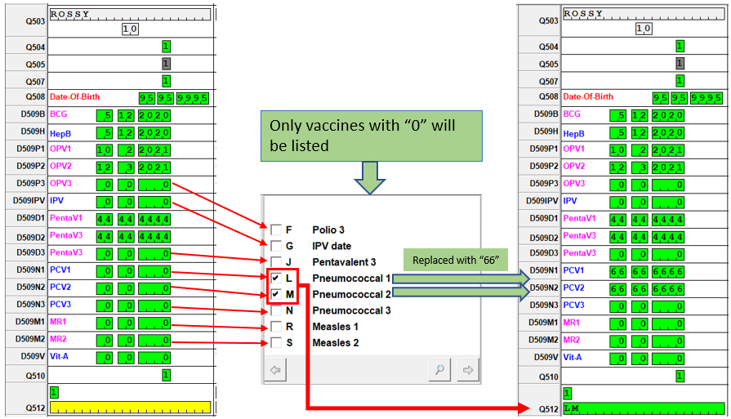
Example for Q512 additional vaccines
Notes:
At DHS we define a CAPI operation as a

Slide 15
THANK YOU
Questions or Comments?

